Slide 1

Determining Movie Box Office Success
Caitlin Casey • Tim Skinner • Charmaine Stennett • Paige Williams
Fusion, Inc.
Netflix
September 11, 2019
Notes:
:

Slide 2
Executive Overview
Introduction
Our group Fusion, Inc. assessed the TMDB 5000 Movie Dataset. This dataset takes information extracted from IMDb (the Internet Movie Database) to assess movie data. Motivation
As a group we like movies, and we thought this dataset would be a fun way to analyze a common interest. Problem Statement
Is there a way to predict a movie's success based on critical review and public review?
Notes:
Caitlin

Slide 3
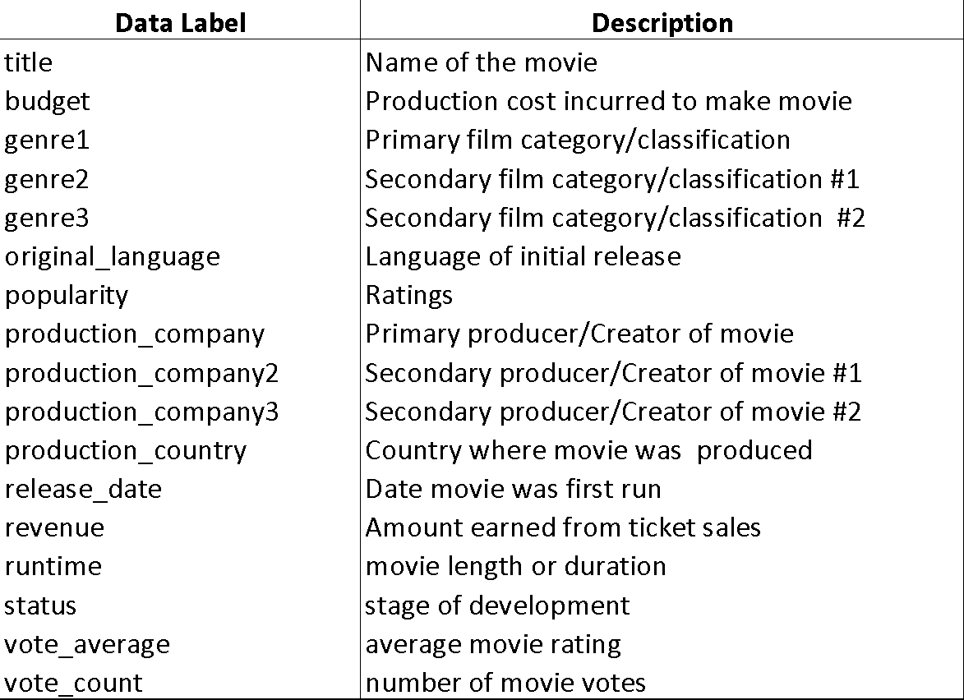
Data Dictionary
Notes:
Caitlin/Paige

Slide 4
Data Question
Is there a predictive trend or formula that can be used to estimate a films box office success?
What variables or attributes drive box office success?
What causes a box office flop?
Which film generated the highest and lowest Revenue and ROI?
How much impact do genres, actors, directors, movie studios/production companies have on the success of a film.
Are there significant relationships between dependent (revenue) and independent variables? What is the relationship between budget and revenue?
Notes:
Paige

Slide 5
Data Sources
TMDB 5000 Movie Dataset
The data consists of 3,183 observations and 19 variables.
The data is comprised of data points geared towards film
https://www.kaggle.com/tmdb/tmdb-movie-metadata
Notes:
Paige

Slide 6
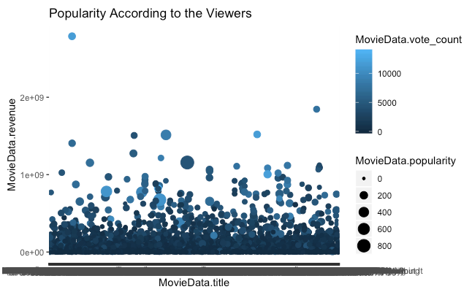
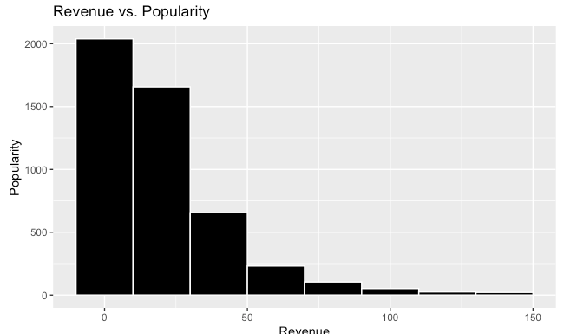
Visualizations of the Data
3,183 observations
19 variables/attributes:
Notes:
Paige/Caitlin

Slide 7
Data Analysis Tools
Descriptive Analytics
Financial Analytics
Linear Regression Model
Tested multicollinearity based on the variance inflation factor (vif).
KSVM Model
Scaled Scores for Variables
Notes:
Charmaine

Slide 8
Financial Analytics
Gross Profit/Net Revenue
“Avatar” generated the highest gross and net revenue at $2.8 Billion
“I Married a Strange Person” generated the lowest gross revenues at $203,000 and recorded a loss of
“The Lone Ranger” incurred the highest net loss of $165.7 Million
ROI
“Paranormal Activity generated the highest RO1 of 12,889.39%
“The Adventurer: the Curse of the Midas Box generated negative ROI of -.000744
Notes:
Charmaine:

Slide 9
Linear Regression Model
Initial model using all attributes
Revenue – Dependent Variable
Budget – Independent Variable
Vote Average – Independent Variable
Vote Count – Independent Variable
Runtime – Independent Variable
Popularity – Independent Variable
Attributes identified as significant drivers (with high R-squared and low p-value):
Budget – Independent Variable
Vote Count – Independent Variable
Popularity – Independent Variable
Selected the best model after streamlining

Slide 10
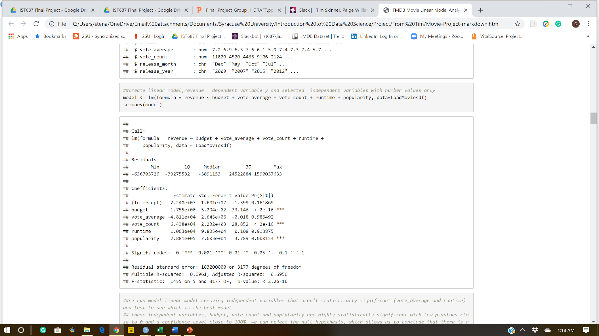
Linear Regression Model – Unadjusted
Notes:
Charmaine:
Ran an initial linear regression model and we can conclude that:
Has an Adjusted R-Squared of 69.56%, which indicates that 69.56% of a change in revenue (dependent variable) can be explained by changes in the independent variables. onof the variability of the response data around its mean and therefore is not a perfect fit.
The model shows that independent variables budget, vote count and popularity are strong predictors of revenue and are considered statistically significant given their low p-values very close to zero, which indicates that we can reject the null hypothesis.
However note that vote average and runtime are not strong predictors of revenue given their very high p-values of 98.5% and 91.4%, respectively. As a result we excluded these two independent variables and ran the model again.
We ran a linear regressin

Slide 11
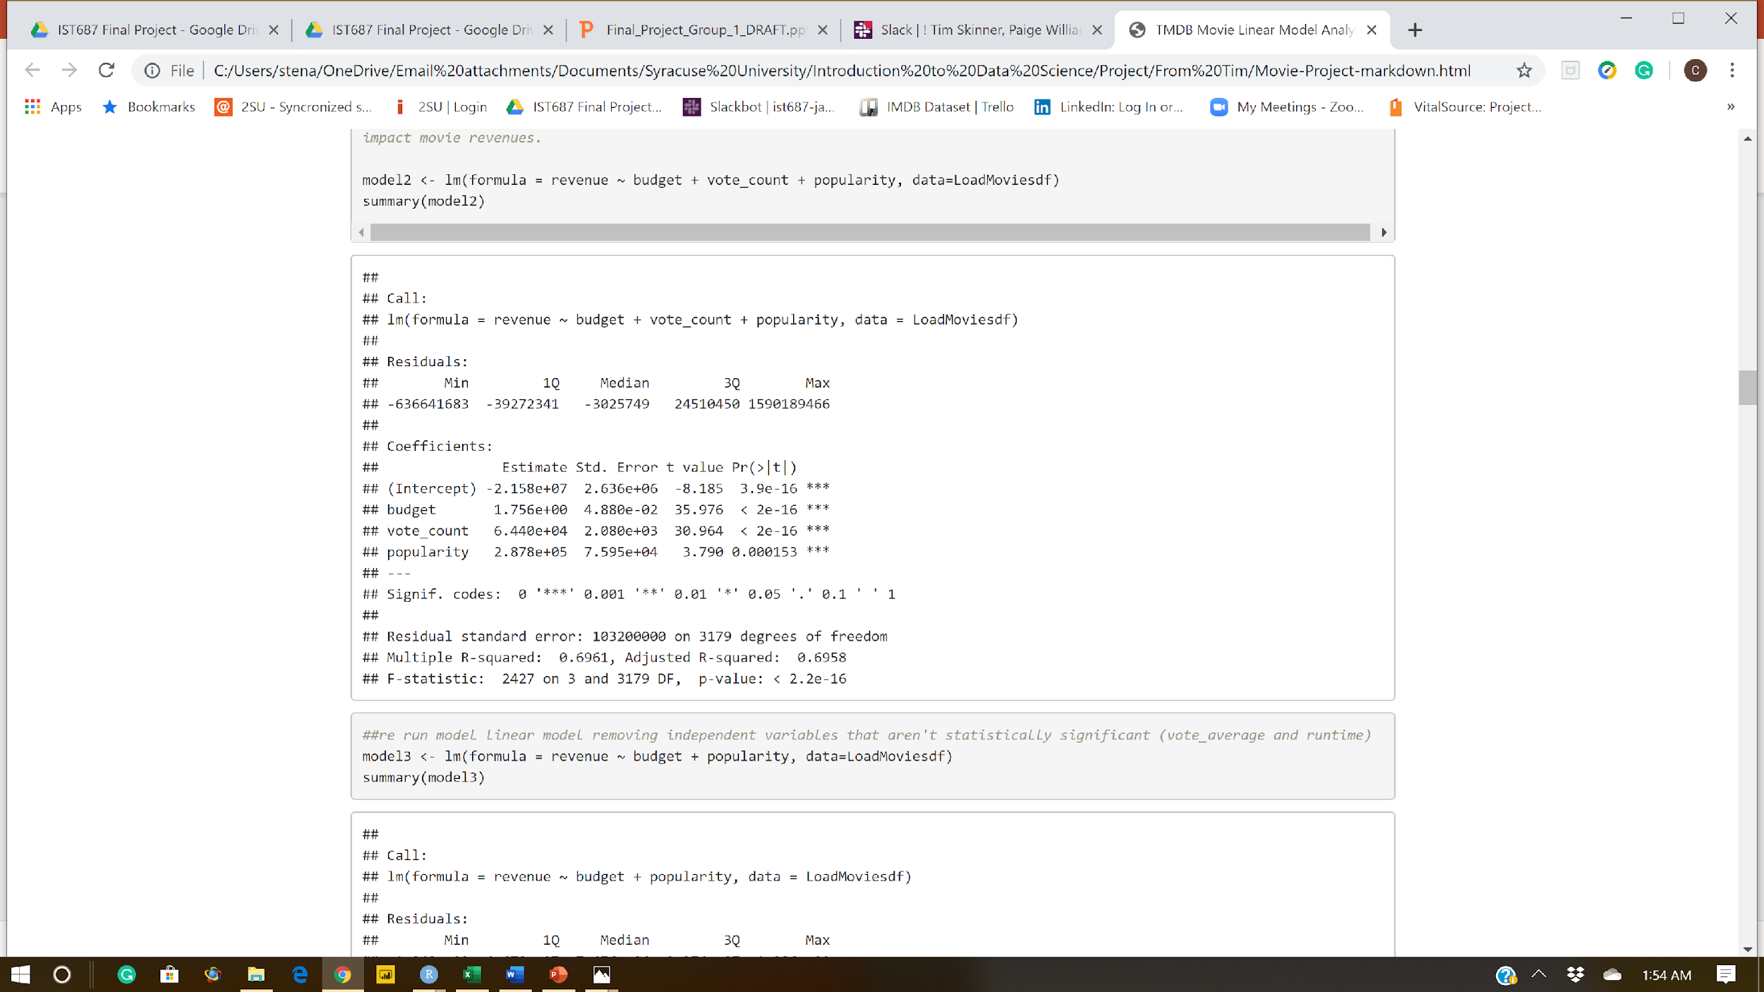
Linear Regression Model - Adjusted
Notes:
Charmaine:
Budget, vote count and popularity are strong predictors of revenue given low p-values of very close to zero and confidence level of close to 100%. As budget, vote count and popularity increases revenue increases.
Adjusted R-squared only changed marginally and indicates that only 69..6% of a change in revenue can be explained by changes in the budget, vote count and popularity. Indicating that the model explains only 69.6 % of the variability of the response data around its mean. Though not a perfect fit, this model represents the best fit.

Slide 12
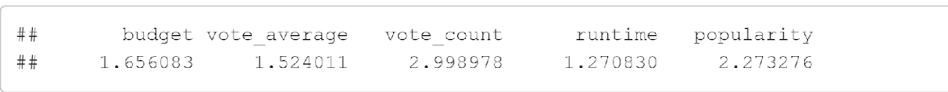
Linear Regression Model – Multicollinearity Low VIF
Notes:
Charmaine:
Multicollinearity occurs when predictors in the model are correlated with other predictors. We used the variance inflation factor (VIF) to test for multicollinearity. A VIF of 10 or more indicates high multicollinearity in the model. Multicollinearity increases the standard errors of the co-effecient. Therefore by overinflating the standard errors multicollinearity makes some variables statistically insignificant when they should be significant. From our results we can see that all independent variables in the model have a VIF of less than 3, which indicates that multicollinearity does not exist in the model.
If multicollinearity exists you would exclude the variable from the model.

Slide 13
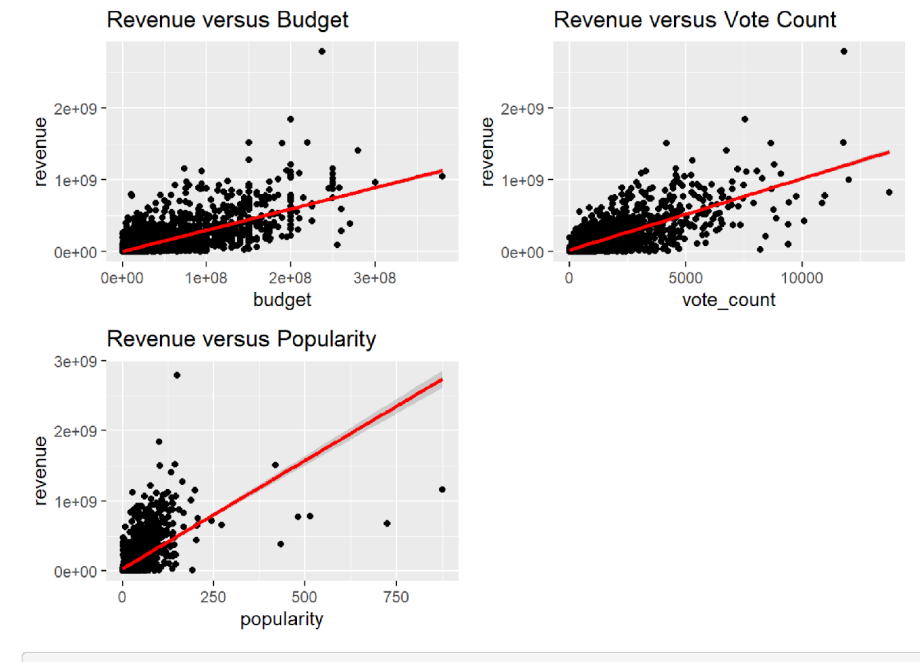
Linear Regression Model - Plots
Notes:
Charmaine:
This represents a plot to show the model fit with each independent variable

Slide 14
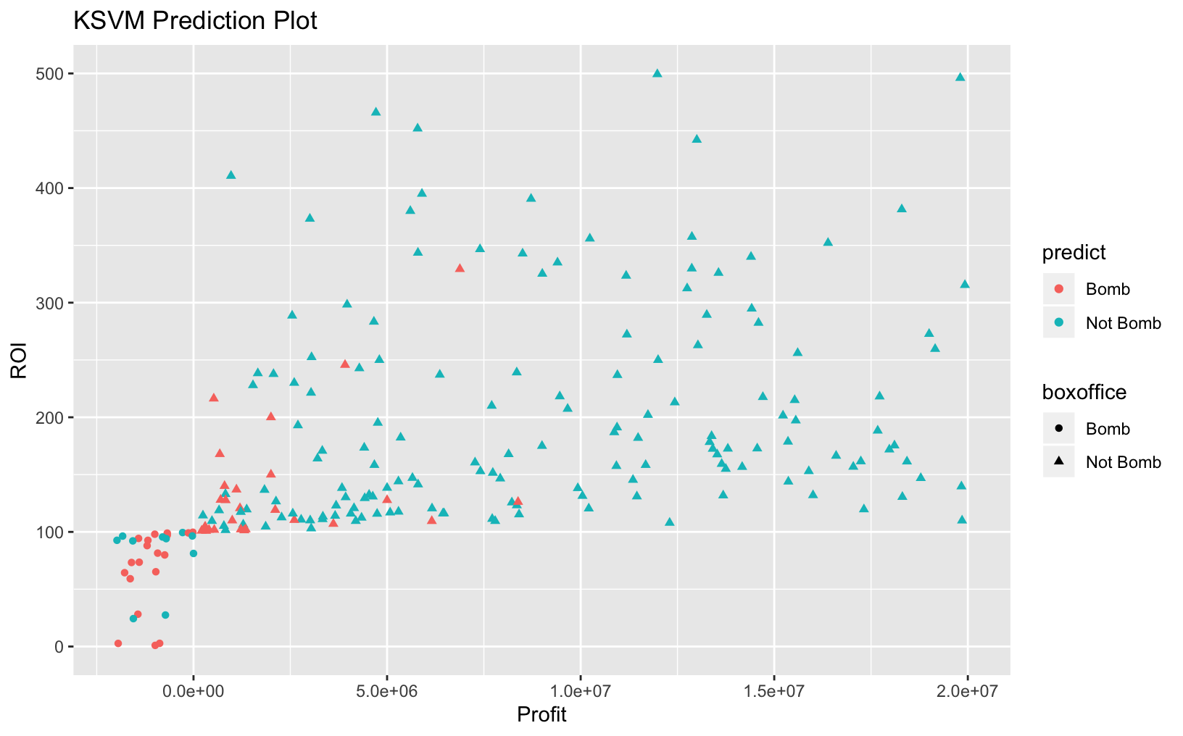
Predicting Box-office Bombs
KSVM Machine Learning Algorithm Used
Model predicted correctly 94% of the time!

Slide 15
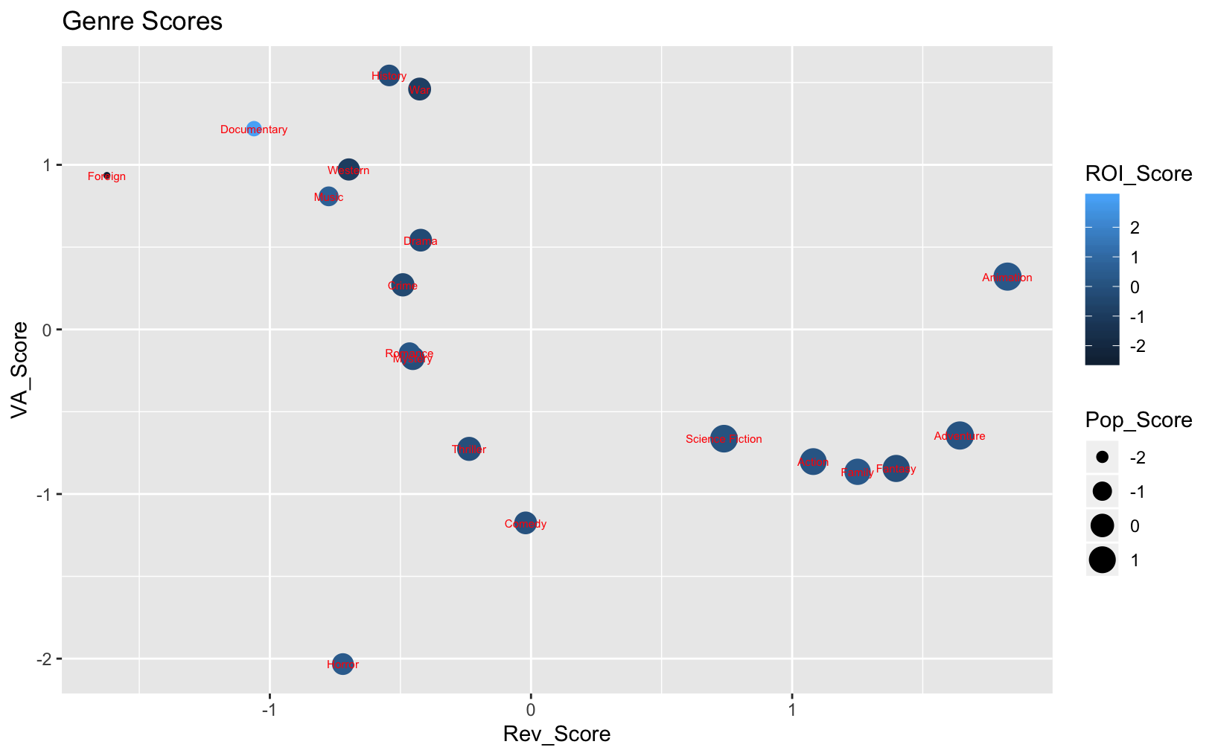
Genre Score
Assign a “score” to each genre for Revenue, Vote Average, Popularity and ROI
Top 3 Genres
1. Animation
2. Adventure
3. Fantasy

Slide 16
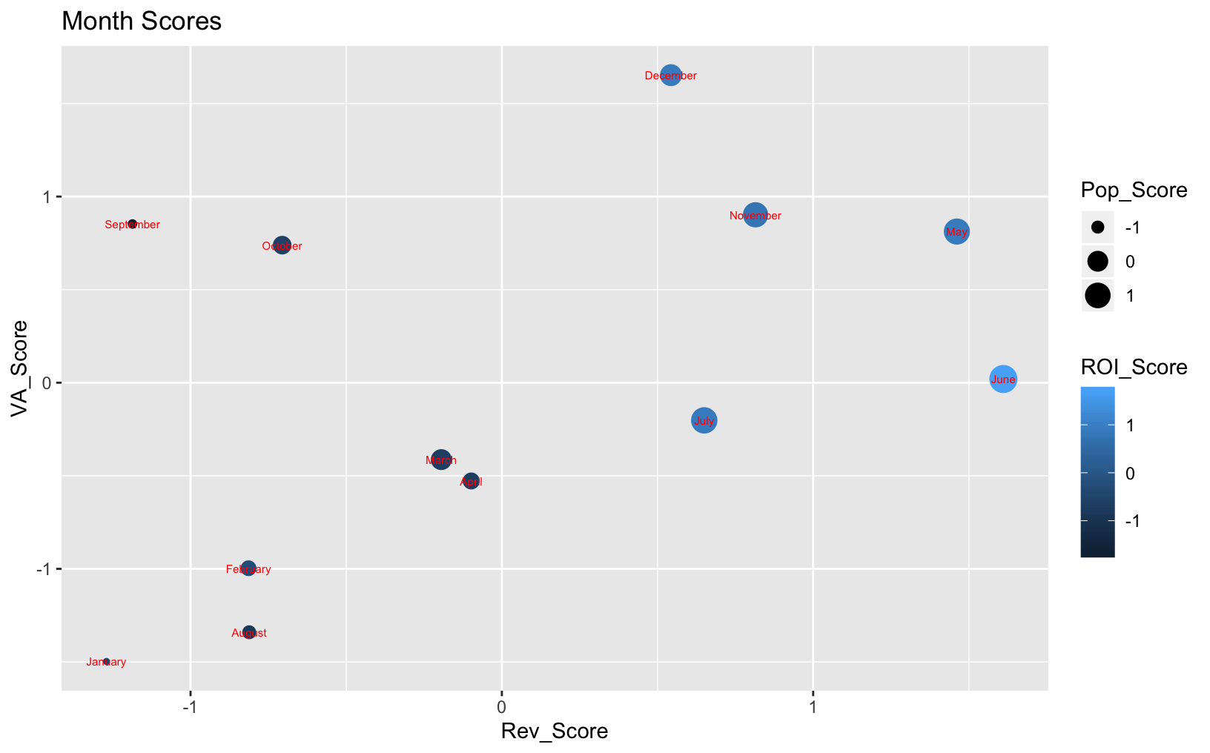
Month Score
Top 3 Months
1. June
2. May
3. November

Slide 17
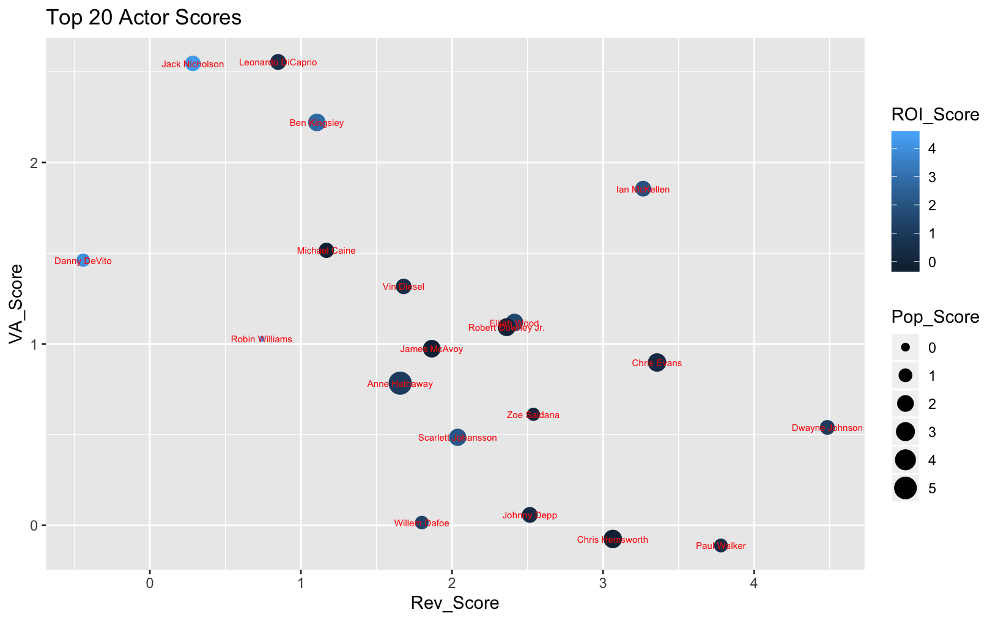
Actor Score
Determining the most successful actors based on Revenue, Popularity, Vote Average and ROI
Top 3 Actors
1. Anne Hathaway
2. Ian McKellan
3. Jack Nicholson
Top Actor Scores by Category
Revenue
Vote Average
Popularity
ROI
1. Dwayne Johnson
2. Paul Walker
3. Chris Evans
4. Ian McKellan
5. Chris Hemsworth
1. Leonardo DiCaprio
2. Jack Nicholson
3. Jennifer Connelly
4. Ben Kingsly
5. Mark Ruffalo
1. Anne Hathaway
2. Matthew McConaughey
3. Chris Hemsworth
4. Chris Evans
5. Robert Downey Jr.
1. Robin Williams
2. Jack Nicholson
3. Danny DeVito
4. Hugh Grant
5. Jennifer Garner
Notes:
Tim

Slide 18
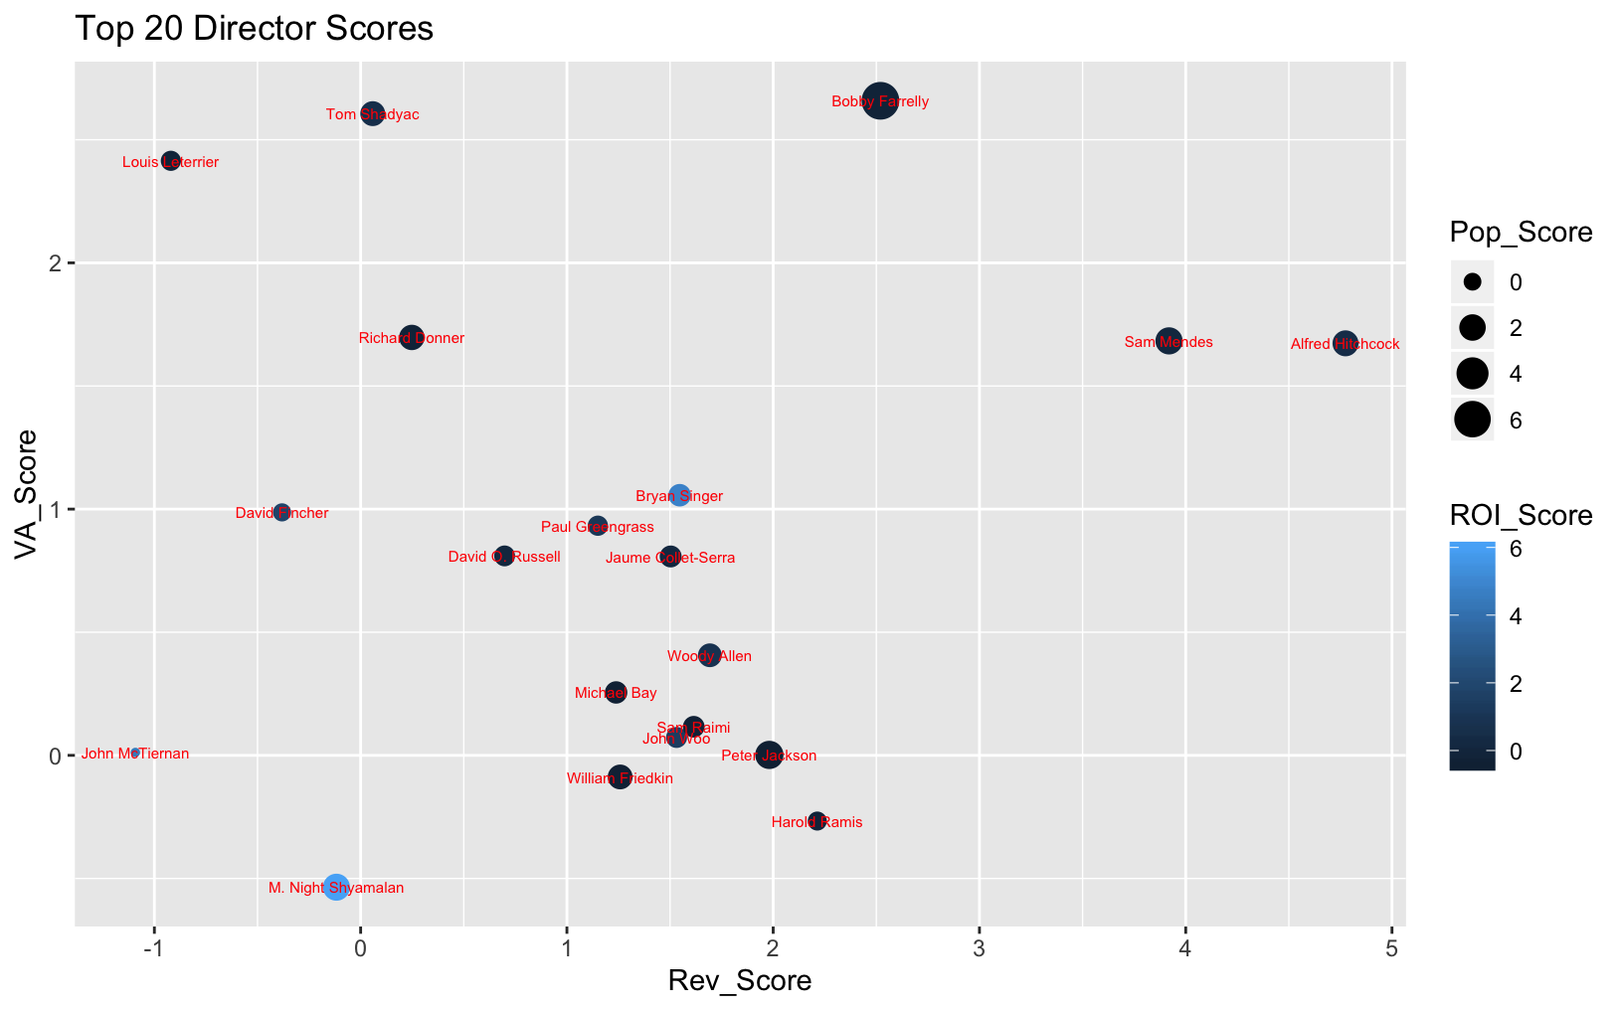
Director Score
Top 3 Directors
1. Bobby Farrely
2. Alfred Hitchcock
3. Bryan Singer
Top Director Scores by Category
Revenue
Vote Average
Popularity
ROI
1. Alfred Hitchcock
2. Sam Mendes
3. Bobby Farrelly
4. Harold Ramis
5. Peter Jackson
1. Bobby Farrelly
2. Tom Shadyac
3. Louis Leterrier
4. Roman Polanski
5. Gore Verbinski
1. Bobby Farrelly
2. Peter Jackson
3. Sam Mendes
4. M. Night Shymalan
5. Alfred Hitchcock
1. M. Night Shymalan
2. Bryan Singer
3. John McTiernan
4. Andrew Niccol
5. David Fincher

Slide 19
Conclusions
The old adage rings true: You have to spend money to make money!
Predicting a movie’s ROI is difficult, but our model can predict fairly accurately whether or not a movie will be a bomb or not.
How to make a movie that will get the most views:
Genres: Animated, Action, Adventure
Actors: Dwayne Johnson, Ian McKellon, Chris Evans
Director: Sam Mendes
Release month: June
What types of movies should you add to streaming?
Genres: Adventure, Animation, Science Fiction
Actors: Anne Hathaway, Matthew McConaughey, Chris Hemsworth
Director: Bobby Farrelly
Release Month: June
How to make a movie to win an Oscar
Genres: Western, Historical, War
Actors: Leonardo Dicaprio, Jennifer Connelly, Ben Kingsly
Director: Ben Farrelly
Release Month: December

